Slide 1

CPRG 210 Web Application Development
Module 5: Arrays, DOM, and Events

Slide 2
Outlines
Arrays
DOM
DOM concepts
Accessing HTML Elements using getElementById(), getElementsByClassName(), querySelector(), getElementsByTagName(), querySelectorAll().
Creating HTML Elements using JS.
DOM Navigation/Traverse
Events and Event Handlers

Slide 3
Arrays
Array
Collection of Related Data Items: Non-Primitive
Dynamic: Size is Changeable
Array Elements: Group of Memory Locations
Same Name and Different Data Type – Different Index
C[0]: index = 0 → position in the array
C[0] | -45
C[1] | 6
C[2] | 0
C[3] | 72
C[4] | 14
C[5] | 35
C[6] | -98
Array Name = C with 10 Elements
Accessing Elements : C[index]
If the Array has i-Elements, 1st Index = 0 & Last Index = i - 1
1st Element : C[0]
7th Element : C[6]
It can be used to reduce # of variable names
It can be used to create more efficient programs
Notes:
A lightweight programming language is one that is designed to have very small (small memory space) memory footprint, is easy to implement (important when porting a language), and/or has minimalist syntax and features.

Slide 4
Arrays
Array
Follow Same Naming Rules of Variables
Array is Object → Attributes and Methods
arrayName.length → Array Size
Methods: toString(), sort(), reverse()
Creation
1. var array_name = [Value1, Value2, ….];
var courseCode = [“CMPN215”, “CMPP257”,…];
var person = [“John, “Doe”, 46];
Notes:
A lightweight programming language is one that is designed to have very small (small memory space) memory footprint, is easy to implement (important when porting a language), and/or has minimalist syntax and features.

Slide 5
Creating Arrays
2. var arrayName = new Array(V1, V2, …);
var courseCode = new Array(“CMPN215”, “CMPP257”,…);
Creation
3. var array_name = new Array (No_Of_Elements);
var players = new Array(50); // Not Initialized
4. var array_name = new Array ();
var players = new Array(); // Size is not specified

Slide 6
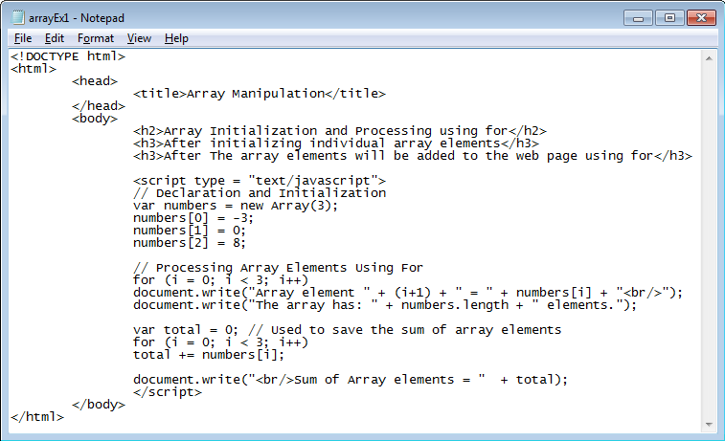
Arrays: Example 1
Declaration & Initialization
Reading Elements
Addition

Slide 7
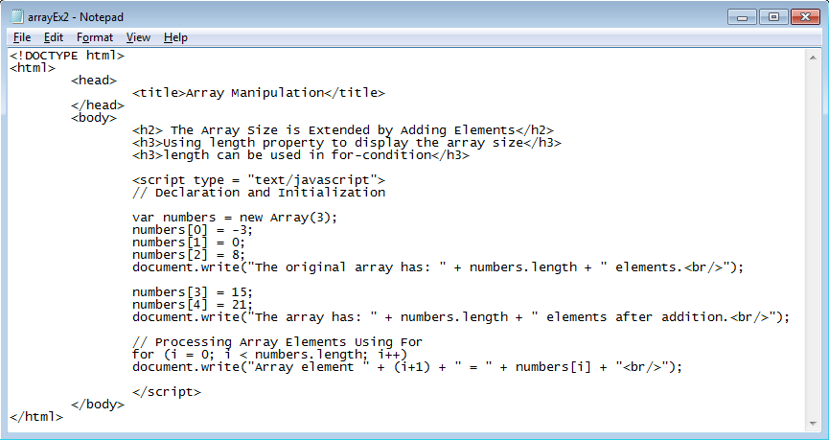
Arrays: Example 2
Add More Elements

Slide 8
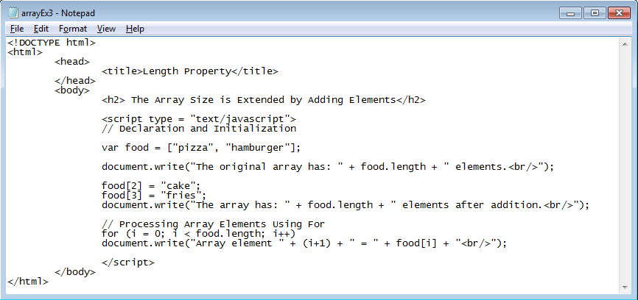
Arrays: Example 3
String Array
String = Array of Characters
JavaScript Example -- String variables
JavaScript Arrays & Date()

Slide 9
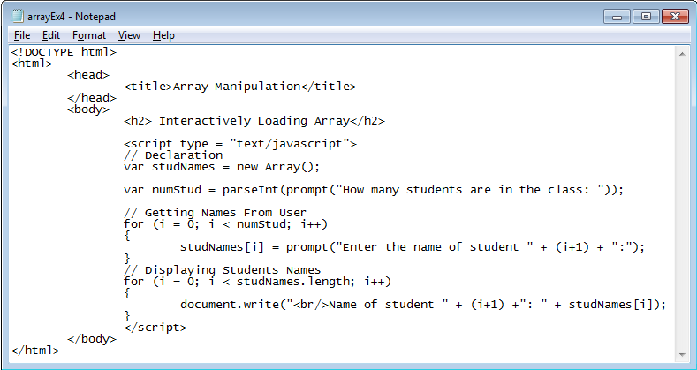
Loading Array Interactively Example
User Fills Student Array

Slide 10
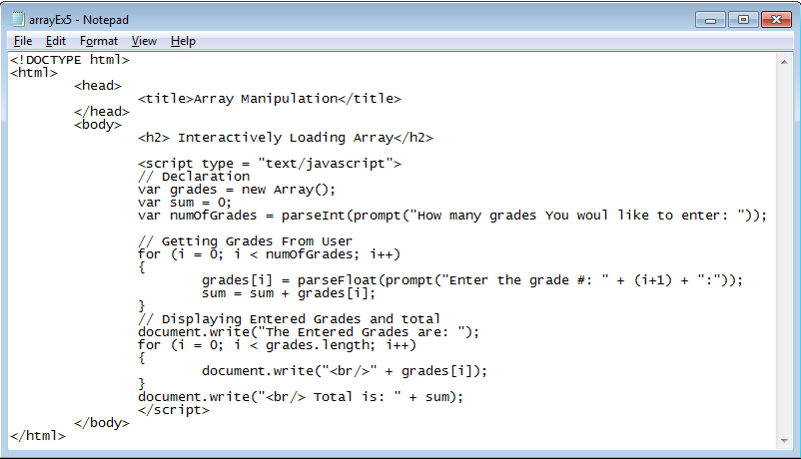
Loading Array Interactively Example
Read Grades & Calculate Sum
Other Types of Arrays?

Slide 11
Document Object Model
Document = WEB Page
Model: Graphical Representation of a WEB Page
DOM
Based on Object: Thing Grouping Properties & Methods
Browsers Create DOM of HTML Pages
Used to Access/Modify HTML Page (Content & Styles)
DOM Components: Nodes | Parent-child relationship between nodes
Nodes: Parent, Child, or Sibling | Nodes: Element, Attribute, or Text
JavaScript document lastModified

Slide 12
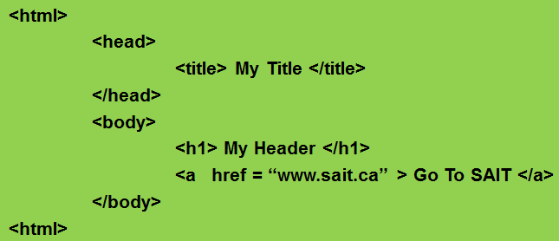
DOM
Element Node Contained in <>
Document
Root Element: <html>
Parent
Element <head>
Sibling
Element <body>
Parent/Child
Element <title>
Element <h1>
Element <a>
Attribute “href”
Text “My title”
Text
“My Header”
Text
“Go To SAIT”
Text Node – Cannot Have Children
Attribute Node – Cannot Have Children
Notes:
Element node corresponds/represents HTML elements/tags and contained in <>
Text node represents text/content between <> and </>
Attribute node represents attributes of HTML elements

Slide 13
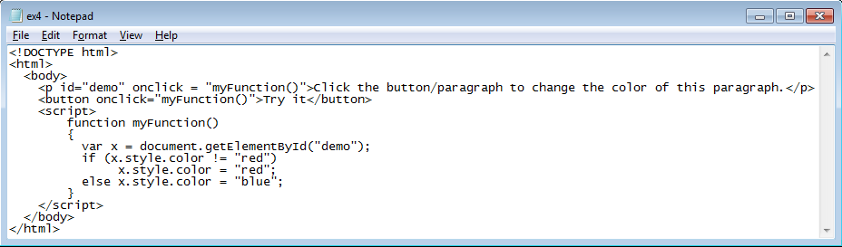
Accessing HTML Elements
Returns the Element with the Specified ID
document.getElementById(“ElementID”);
getElementById()
The Most Desirable and Common Method
1st Step to Manipulate HTML Elements
Get Reference to the Target Element
Modify the Element’s color attribute

Slide 14
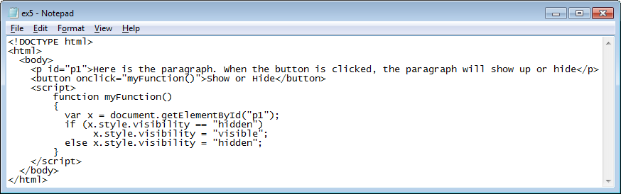
Accessing HTML Elements
JavaScript div innerHtml
Get Reference to the Target Element
Modify the Element’s visibility attribute
alert(document.getElementById(“p1”).innerHTML);
document.getElementById(“p1”).innerHTML = “New Paragraph”;
innerHTML: Property
Set or Return the Content of an HTML Element.

Slide 15
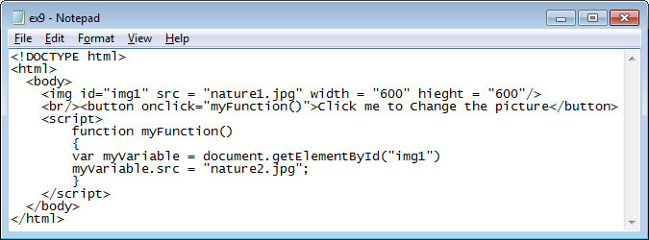
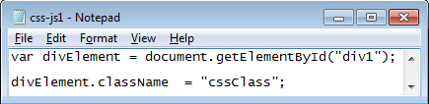
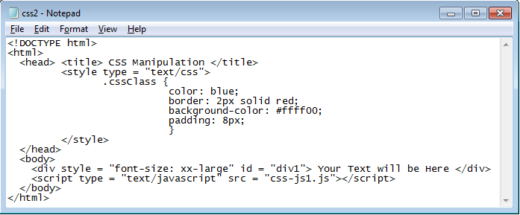
Accessing HTML Elements
Changing src Attribute for <img> Element

Slide 16
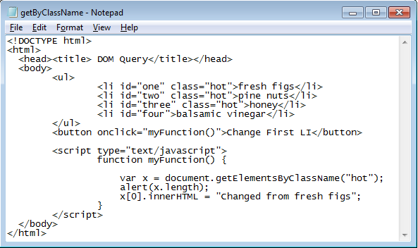
getElementsByClassName()
document.getElementsByClassName(“classname”);
getElementsByClassName(‘hot’);
ul
Returns a Collection of Elements (NodeList) with the Specified Class Name
li:0
li:1
li:2
li
Index : o to length-1

Slide 17
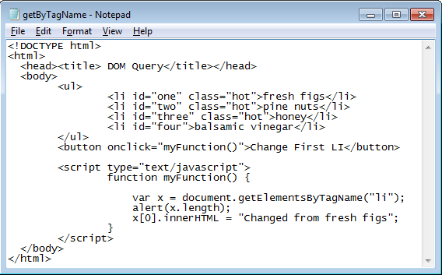
getElementsByTagName()
document.getElementsByTagName(“Tagname”);
getElementsByTagName(‘li’);
ul
Returns a Collection of Elements (NodeList) with the Specified Tag Name
li:0
li:1
li:2
li:3
Index : o to length-1

Slide 18
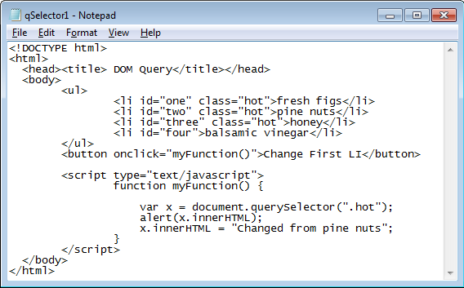
querySelector()
CSS Selector → ID, ClassName, etc.
querySelector(“.hot”);
ul
querySelector(“#two”);
Returns the 1st Element Matching a Specified CSS Selector(s)
li
li
li
li

Slide 19
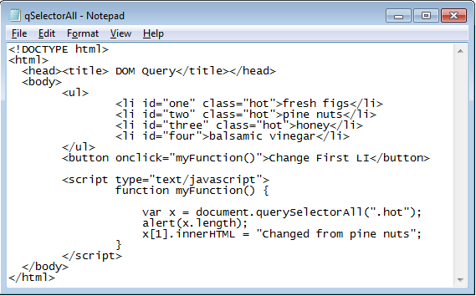
querySelectorAll()
querySelectorAll(“CSS Selector”);
ul
querySelectorAll(‘.hot’);
Returns All Elements Matching a Specified CSS Selector(s)
li:0
li:1
li:2
li
NodeList: Index → 0 to length-1

Slide 20
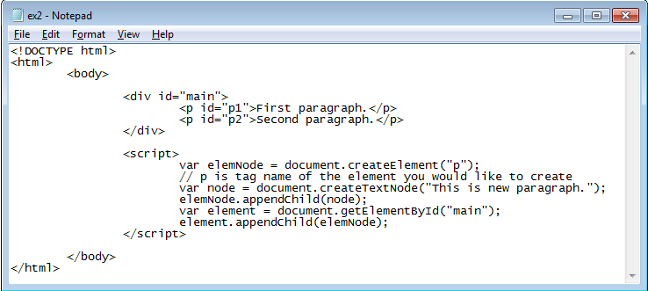
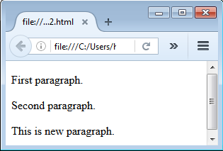
DOM: Creating HTML Element
1
2
3
4
5

Slide 21
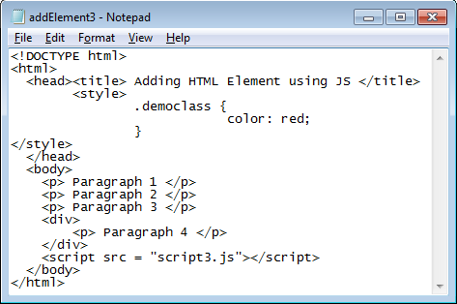
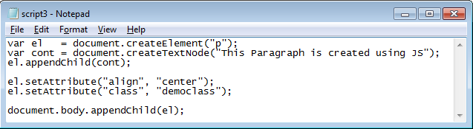
Creating Element Node

Slide 22
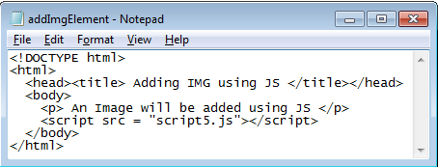
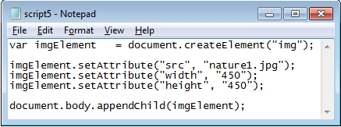
Creating Image Node
1
2
3

Slide 23
Navigating/Traversing
Methods for retrieving nodes related to current node
childNodes() | childElementCount() | nextSibling()
parentElement() | nodeType() | previousSibling()
nodeName()
Methods for inserting and manipulating nodes related to current node
appendChild() | insertBefore()
replaceChile() | removeChild()
Methods for inserting and manipulating attributes of current node
getAttribute() | setAttribute()
removeAttribute() | Attributes()
http://www.w3schools.com/jsref/dom_obj_document.asp
http://www.w3schools.com/jsref/dom_obj_all.asp

Slide 24
Event Handlers: Concepts
Things a User or Browser Does
Event
User-Related Events → Clicking a Mouse
Browser-Related Events → Updating Clock, Loading Page
Firing an Event → The Event Happens
Event Handling
Capturing Events and Responding to Them
Script Reaction (e.g., Function Call )
Reaction to User Actions → Interactive Website
Event-Driven Scripts: Scripts with the Ability to Capture and Respond to Events
Notes:
Events are the actions that occur as a result of browser activities or user interactions with the web pages.
Such as the user performs an action (mouse click or enters data)
We can validate the data entered by a user in a web form
Communicate with Java applets and browser plug-ins

Slide 25
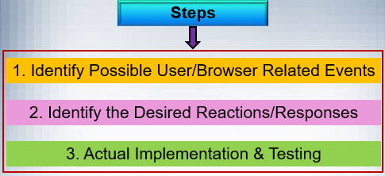
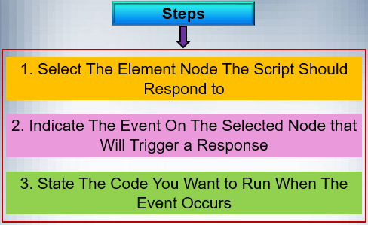
Event Handlers: Concepts

Slide 26
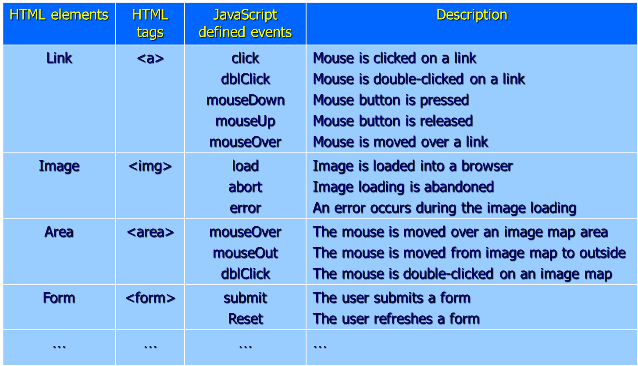
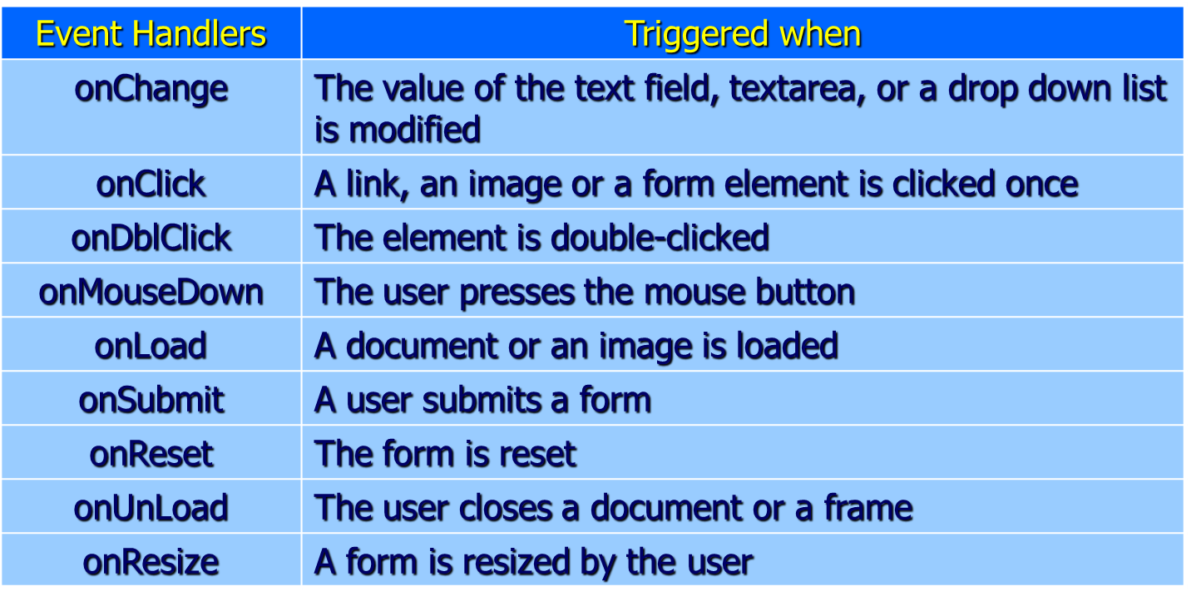
Event Types & Handlers
onError, onAbort, onUnload, onChange
onMouseUp, onFocus, onSelect, okKeyDown, onKeyUp, etc.
Notes:
Keydown: A key is pressed down. Keypress: A character key is pressed. Keyup: A key is released.

Slide 27
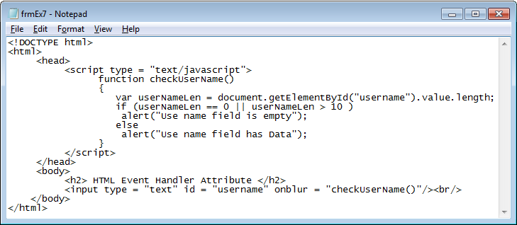
Event Handlers
HTML Event Handler Attribute
Binding an Event to HTML Element
Traditional DOM Event Handlers
DOM Level 2 Event Listeners
HTML Event Handler Attribute
<HTML Tag eventHandler = “JS Code”>
Notes:
Onblur → when the text field loss the focus
There are three ways to bind an event to an element: HTML event handler attributes → our Focus Traditional DOM event handlers DOM Level 2 event listeners

Slide 28
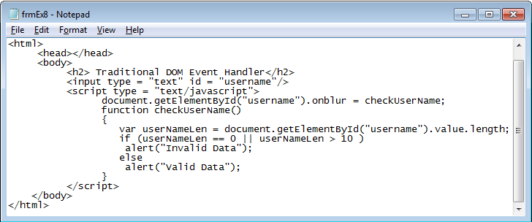
Traditional DOM Event Handlers
el.onblur = checkUsername;
<form>
<input type=text name=“field1” value=“Hi!” onChange=“alert(‘Hey, The field changed!!’);” />
</form>
<form>
<input type=“button” name=“but1” value=“OK” onClick=“function1( );” />
</form>
Notes:
Without parentheses you're not actually calling the function. A function name without the parentheses is a reference to the function.
We don't use the parentheses in that code because we don't want the function to be called at the point where that code is encountered. Instead, we want to pass a reference to our function into the .focus() method and that method will call our function for us whenever the element receive focus.

Slide 29
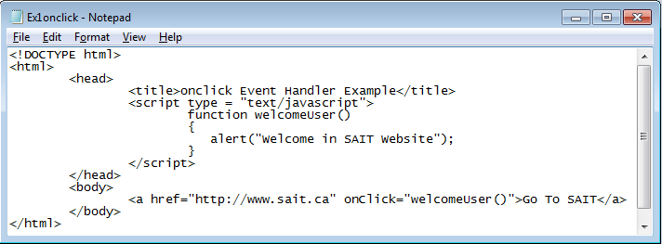
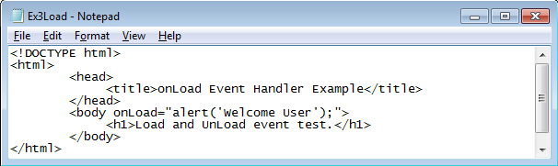
onClick & onLoad Event Handlers
onUnload="alert(‘Good-bye’);"
Notes:
A lightweight programming language is one that is designed to have very small (small memory space) memory footprint, is easy to implement (important when porting a language), and/or has minimalist syntax and features.

Slide 30
onClick & onMouseover Event Handlers
<form>
<input type="button" Value="Click for Yellow" onClick="document.bgColor='yellow'“ />
<input type="button" Value="Click for Red" onClick="document.bgColor='red'“ />
<input type="button" Value="Click for Blue" onClick="document.bgColor='blue'“ />
<input type="button" Value="Click for Green" onClick="document.bgColor='green‘ /">
<input type="button" Value="Click for White" onClick="document.bgColor='white'“ />
</form>
<form>
<input type="button" Value="Yellow" onMouseover="document.bgColor='yellow'“ />
<input type="button" Value="Red" onMouseover ="document.bgColor='red'“ />
<input type="button" Value="Blue" onMouseover ="document.bgColor='blue'“ />
<input type="button" Value="Green" onMouseover ="document.bgColor='green'“ />
<input type="button" Value="White" onMouseover ="document.bgColor='white'“ />
</form>
Notes:
A lightweight programming language is one that is designed to have very small (small memory space) memory footprint, is easy to implement (important when porting a language), and/or has minimalist syntax and features.

Slide 31
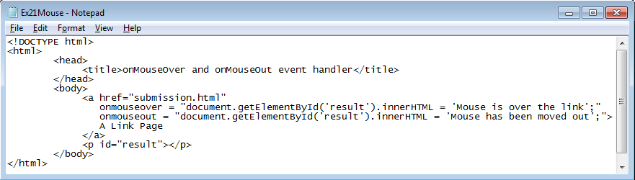
onmouseover & onmouseout
onmousedown_and_up
JavaScript Example -- right mouse button detection
Notes:
Capitalization does not matter

Slide 32
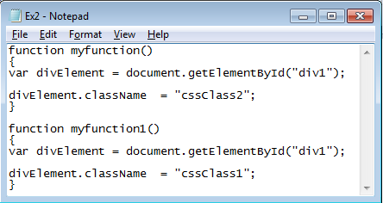
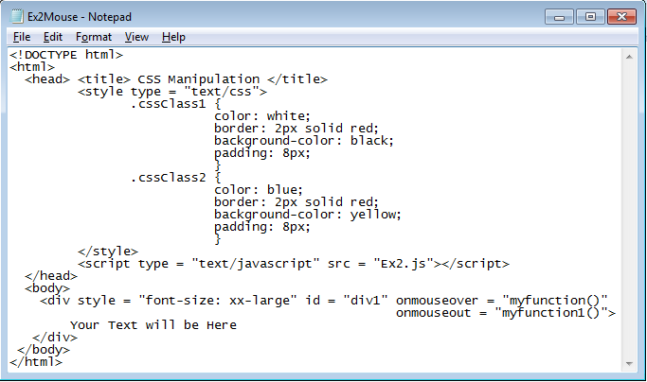
onmouseover & onmouseout
Notes:
Capitalization does not matter

Slide 33
More Examples
<form method="get" action=“http://localhost/bouncer.php”>
Name:<input type="text" name=“name“ /><br />
Phone:<input type="text" name="Phone“ /><br />
<input type="submit" value="Submit“ onClick="return confirm(‘Continue submitting?')“ />
<input type="reset" value="Start Over“ />
</form>
Guess the functionality?
<html>
<head><title>Some Basic Interactvity</title>
<script language="JavaScript">
var first = window.prompt(“Enter Your Name:", " ");
document.write("Hello " + first + “<br />Welcome to my Webpage<br />");
</script>
</head>
<body>
</body>
</html>
JavaScript form-validation
JavaScript form-validation with submit
JavaScript form-validation with onSubmit
Exercise
Do the exercises in “CPRG210 Exercises Day 5.doc”
Notes:
The continue statement will break the current loop and continue with the next value.
When I = 4, the rest of the loop will not be executed and will move to the next iteration (I = 5)

